Slide 1
Obesity Estimation based on eating habits and physical condition
María Colomer, Sara Díez & Gússem Yahia-Cheikh

Slide 2

Goals
Develop multiple supervised classifiers for obesity type prediction
Compare model behavior, interpretability, and sensitivity to data structure
Evaluate individual model performance on a shared dataset
Implement ensemble learning using hard and soft voting strategies
Demonstrate performance gains through model aggregation

Slide 3

Dataset Overview & Preprocessing
17 Features
2111 observations

Slide 4
Dataset Overview & Preprocessing
Underweight
Normal Weight
Overweight type I
Overweight type II
Obesity type I
Obesity type II
Obesity type III
Numerical (3)
17 Features
Target (1)
Categorical (13)

Slide 5
Dataset Overview & Preprocessing
Numerical (4)
Numerical (3)
Binary (5)
17 Features
Categorical (13)
Label Encoding
Ordinal (4)
Nominal (1)
OHE

Slide 6
Exploratory Data Analysis (EDA)
Goals
Target variable Plot
Understand the dataset.
Evaluate the dataset quality.
Find possible issues.
Identify patterns.
Boxplot Analysis
Correlation Matrix
...What about outliers?

Slide 7
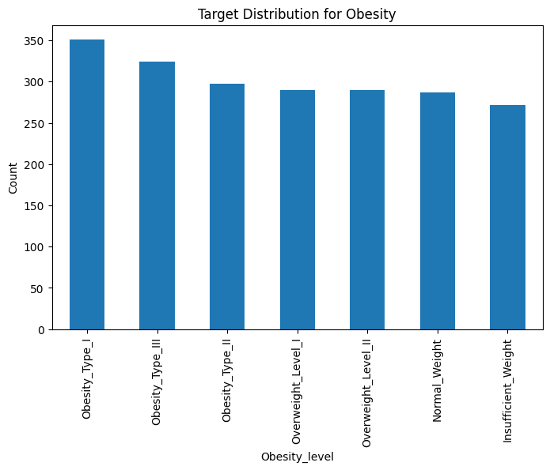
Target Distribution Plot
Aim: visualize the distribution of the target variable.
Unbalanced distributions.
Categorical and multiclass character.
Bias toward majority classes.
Issues in modelling and evaluation metrics.

Slide 8
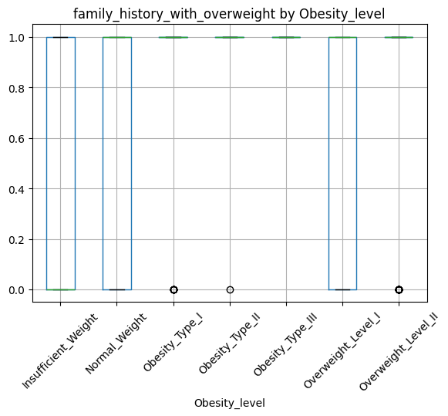
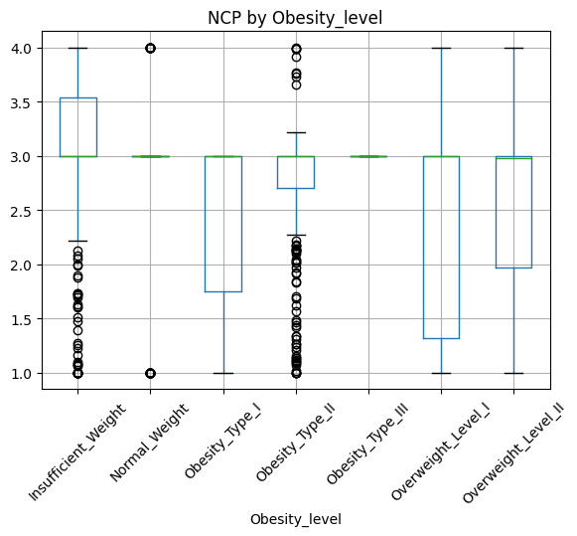
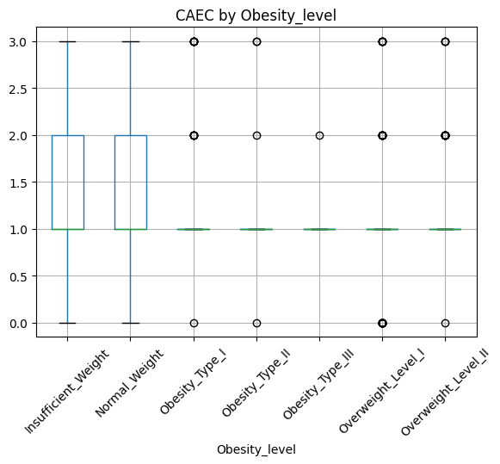
Boxplot by obesity level
Aim: compare numeric features with target variable.

Slide 9
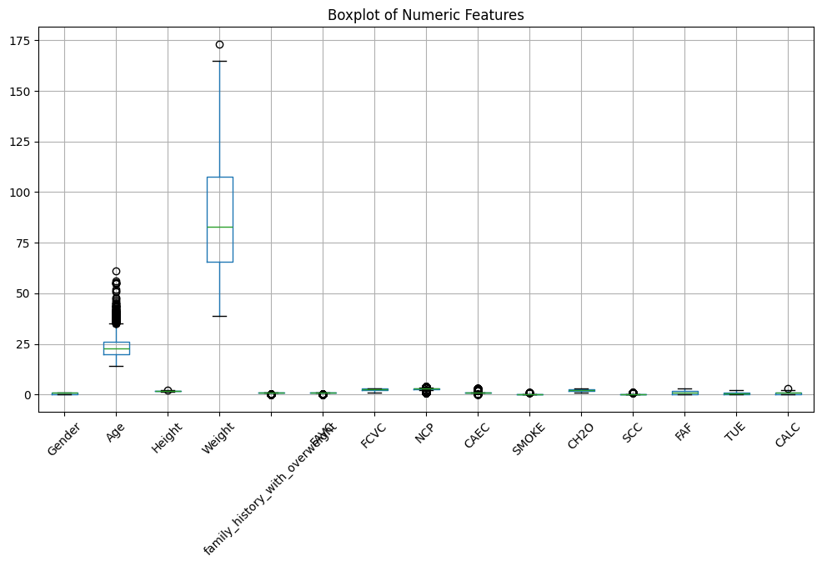
Boxplot for all numeric features
Aim: interpret & inspect spread, skewness & outliers.

Slide 10
Boxplot by obesity level, for all numeric features
Key Interpretations
Identification of relevant features.
Appearance of extreme values.
Must handle outliers for a better result.
+ Results Target Distribution Analysis

Slide 11
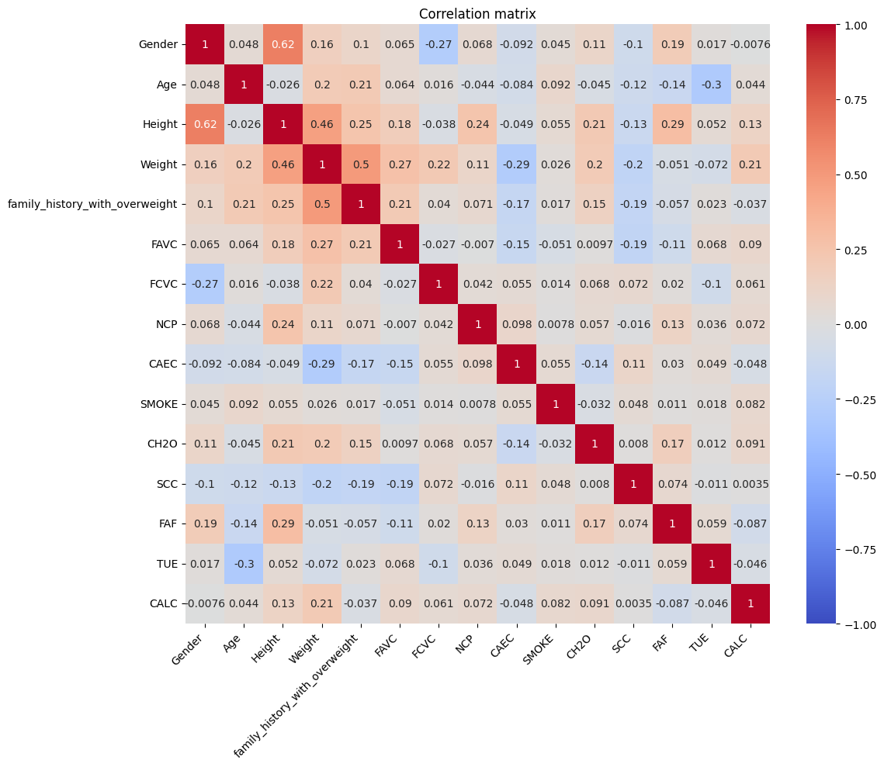
Correlation
Aim: assess relationships between features.
Features highly correlated.
Correlation with obesity metrics.
Redundancy.

Slide 12
Detection & Handling Outliers
Step 1: Detection
IQR METHOD
Step 3: Handling
IQR CAPPING
Total number of outlier values (outliers per column): 1866. Total number of rows that contain at least one outlier: 1131.

Slide 13
Modelling
Tree-Based Models
Statistical and Probabilistic Models
Margin-Based Model
Ensemble Models

Slide 14

Tree-Based Models
Decision Tree
with Hyperparameter Tuning
Step 1: Dictionary of parameters:
{'max_leaf_nodes': list(range(2, 300)), 'min_samples_split': list(range(2, 20))}
Step 2: Grid Search of the Decision Tree Classifier using 5-fold cross validation
Step 3: Training & insights depth: 14 , n_leaves: 217
Step 4: Evaluation accuracy = 0.773

Slide 15
Statistical and Probabilistic Models
Logistic Regression Pipeline
Step 1: Preprocessing Pipeline (Numerical & categorical Features, ColumnTransformer())
Step 2: Preprocessing + Logistic Regression = LOGISTIC REGRESSION PIPELINE
Step 3: Training
Step 4: Evaluation
Accuracy = 55.68 %
ROC AUC (OvR) = 87.46 %

Slide 16
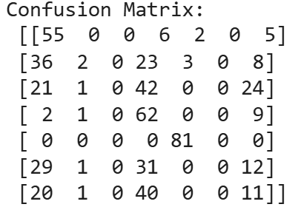
Statistical and Probabilistic Models
Naive Bayes
Step 1: Preprocessing Pipeline (Standard Scalerer() & GaussianNB())
Step 2: Training & predict
Step 3: Training & evaluation accuracy: 0.3996
confusion matrix:

Slide 17
Margin-Based Model
Support Vector Machines
1. Scale the data with StandardScaler()
2. Set parameter C to control the trade-off between margin maximization and classification error.
3. Set non-linear kernel (RBF)

Slide 18
Margin-Based Model
Support Vector Machines
1. Scale the data with StandardScaler()
72% Accuracy
2. Set parameter C.
3. Set non-linear kernel (RBF)

Slide 19
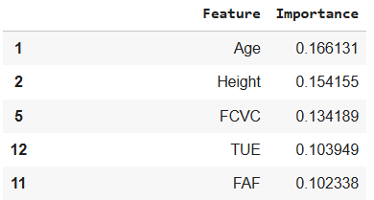
Ensemble Models
Random Forest
Step 1: RandomForestClassifier() parameter tuning:
(n_estimators=200, bootstrap=True, n_jobs=-1, random_state=RANDOM_SEED)
Step 2: Training and evaluation accuracy: 0.8806
Step 3: Feature Importance evaluation

Slide 20
Ensemble Models
Voting Classifier
Step 1: Combining multiple classifiers (LogisticRegression(),GaussianNB(), SVC() & RandomForestClassifier())
Step 2: Training VotingClassifier() with parameters voting='soft' & voting='hard'
Step 3: Compare Classifier accuracies:
LogisticRegression: 0.5095
GaussianNB: 0.3996
SVC: 0.7330
RandomForestClassifier: 0.8826
VotingClassifier (Hard): 0.7235
VotingClassifier (Soft): 0.7292

Slide 21
THANKS
for listening

